Slide 1
Faculty Dr.M.Priyadharshini
CSE4004 – Web Technologies Lab
Assistant Professor Sr.Gr.1

Slide 2
Lab 9
Server Side Scripting – PHP and MySQL
Install WAMP/XAMPP Server and do necessary configurations to host a website.
Create student_info(with Register Number, as primary key) and marks with tables in MySQL as follows

Slide 3
Lab 9- Tables
Student_Info Table
Register Number
Name
Degree
Marks Table
Register Number
Semester
CATNo
SubCode
Mark

Slide 4
Develop a web page with options
Insert – insert values in marks table
Update – update mark of specific row in marks table
Delete – delete marks of a particular register number
Display – marks of a particular register number
Finally host the web page as part of university website hosted on the WAMP/XAMPP Server.

Slide 5
Lab 9- Task
Create a home page with all links specified and page to insert Student Marks.

Slide 6
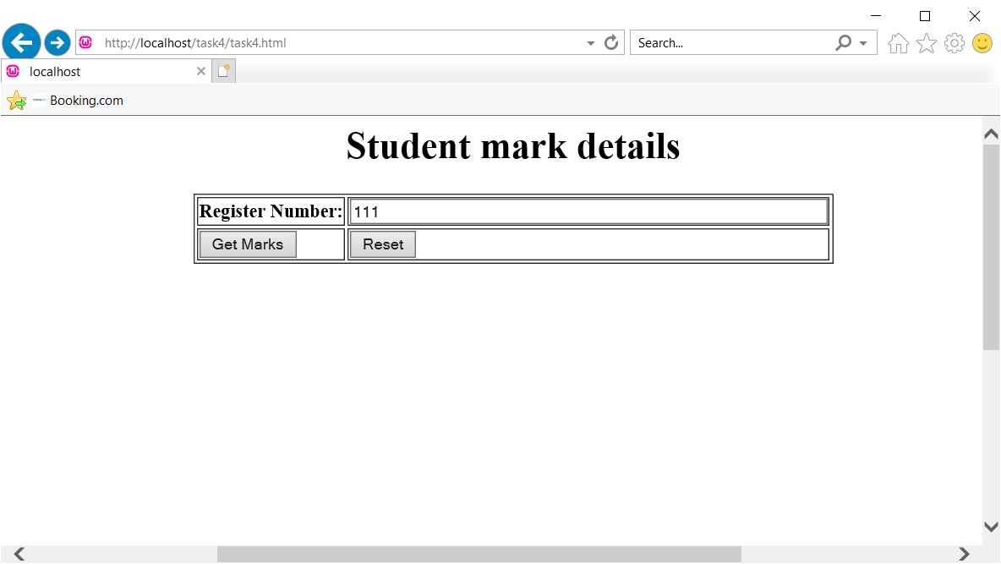
Lab 9 - Task

